Slide 1
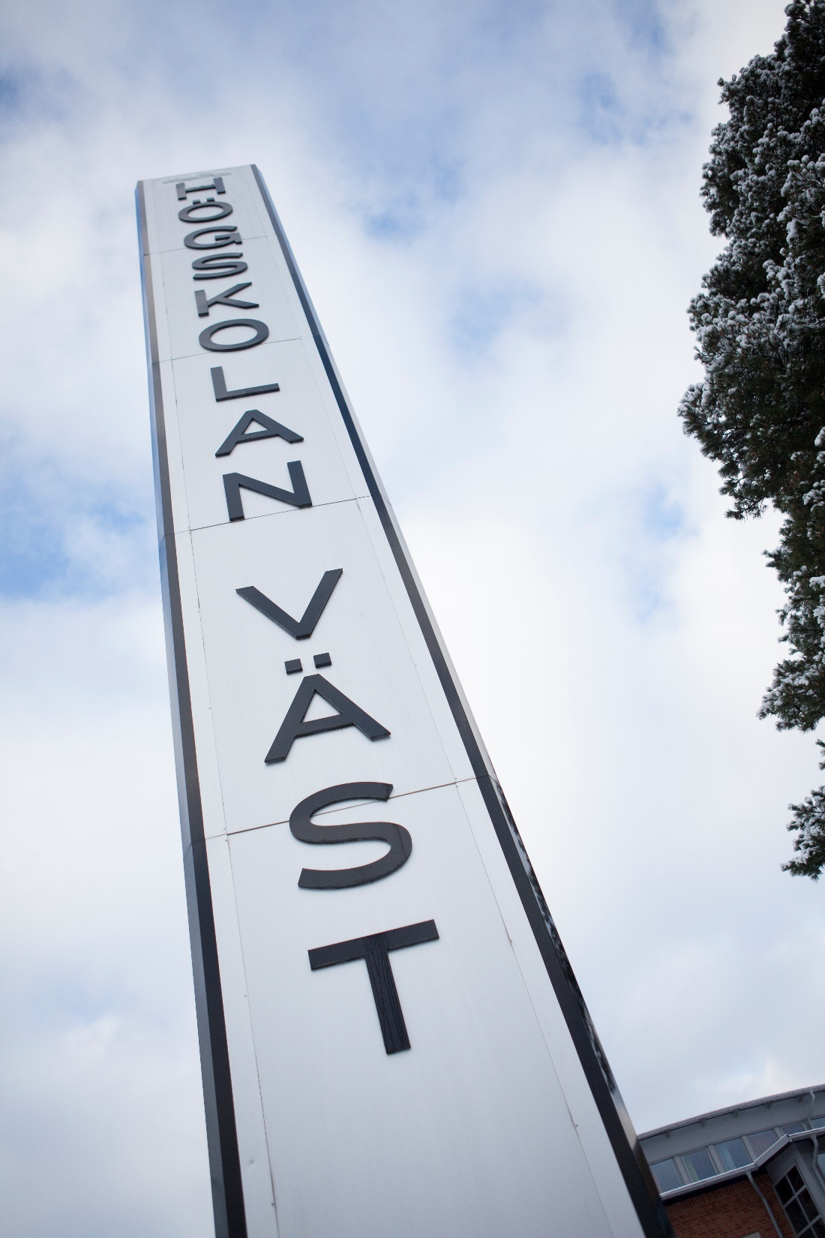
Degree project presentation University West Trollhättan, Sweden www.hv.se/en
Notes:
Do not change this slide

Slide 2
Title
Enhancing Efficiency in Metal 3D Printing Through Heat Simulation and AI
Justine Jean
Production Technology West
Master in AI and Automation Degree project, 21 ECTS credits
University West, Dep of Production System
Trollhättan, Sweden
Date: 2025-06-02
Notes:
All red text shall be replaced AND changed to BLACK colour

Slide 3
Introduction
Metal 3d printing and its industrial significance
Overview of Wire Arc Additive Manufacturing (WAAM)
Importance of thermal Management
Work remotely from PTW, using Robot Studio and python
Notes:
Describe the topic area of your degree project
Introduce the audience in the area
Short presentation of the work environment (PTW or industry)

Slide 4
Aims
Develop a realistic, physics-based simulation model for WAAM
Implement an accurate voxel-based representation of printed pieces
Perform thermal simulations to optimize printing sequences
Use Reinforcement Learning (RL) to autonomously improve build sequences
Notes:
Which are the main aims your degree project should answer
It should be clear, concise, objective and focused
Why are these aims important to answer

Slide 5
Aims
Importance of those aims :
Realism
Flexible
Enhance productivity quality, and reduce production time
Notes:
Which are the main aims your degree project should answer
It should be clear, concise, objective and focused
Why are these aims important to answer

Slide 6
Background
Results from the literature study:
Fundamentals of WAAM and Direct Energy Deposition (DED)
Thermal behavior challenges in metal 3D printing
Voxel-based geometric discretization and its role in thermal simulations
Reinforcement Learning applications in additive manufacturing
Robotic simulation techniques in ABB RobotStudio
Notes:
Results from the literature study
Relevant current research that is close to your topic
Different theories that may apply to your work

Slide 7
Methodology
Methods Chosen:
ABB RobotStudio for virtual WAAM environment setup
Voxel-based geometry pipeline for accurate geometry representation
Heat Simulation model using a given Heat equation
Integration of RL model (Q-Learning) for path optimization
Notes:
The methods that you have chose and why
How was the problem understood, characterized, analyzed or solved?

Slide 8
Methodology
How was the problem understood, characterized, analyzed and solved:
Understood the challenges of WAAM (heat management & optimization).
Characterized the problem by focusing on thermal properties and scheduling inefficiencies.
Analyzed through literature, simulations, and thermal modeling approaches.
Solved effectively by integrating voxel-based heat simulation with Q-learning, resulting in significant performance improvements
Notes:
The methods that you have chose and why
How was the problem understood, characterized, analyzed or solved?

Slide 9
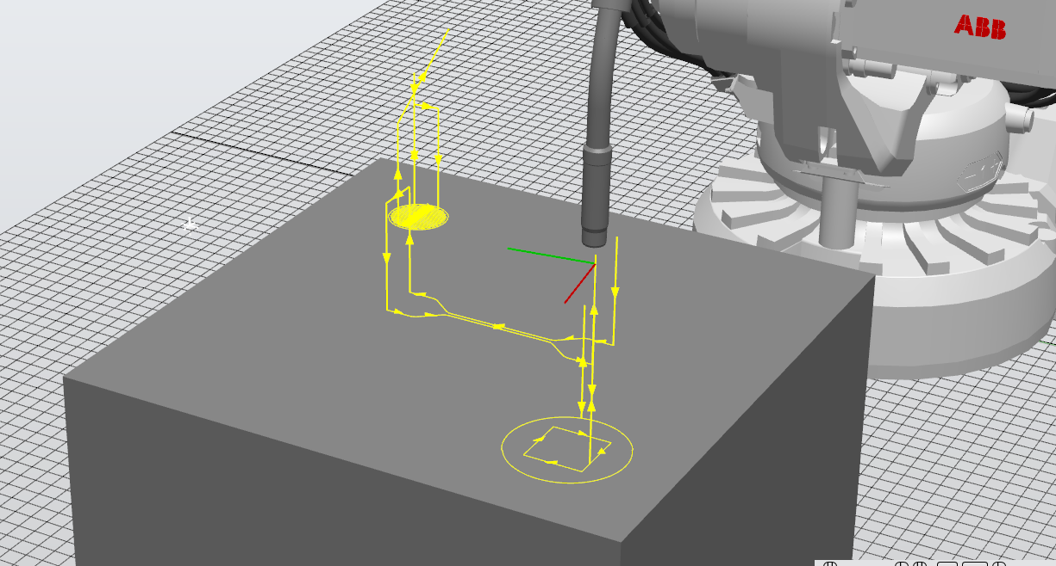
Methodology
ABB Robot Studio for the WAAM simulation
Data collection from the TCP
Reasons :
Real robot is an ABB arm
Simulation allows: trials, flexibility, efficiency and precision
Notes:
The methods that you have chose and why
How was the problem understood, characterized, analyzed or solved?

Slide 10
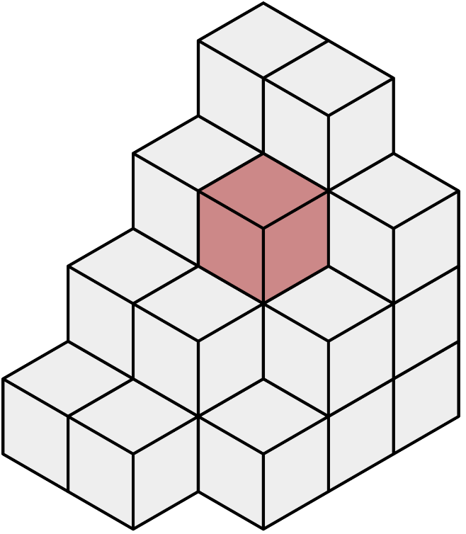
Methodology
Voxel-based geometry pipeline for accurate geometry representation
Regular grid structure: simplify calculation and algorithms, layer’s height are fixed
Easy indexing: facilitates efficient memory management and computational handling.
Adjustable resolution
Supports complex geometries
Direct compatibility with thermal models and Accurate heat maps
Notes:
The methods that you have chose and why
How was the problem understood, characterized, analyzed or solved?

Slide 11
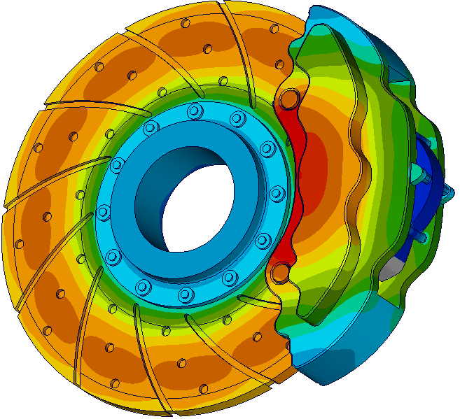
Methodology
Heat Simulation model using a given Heat equation
Computational simplicity
Reduced complexity: captures key heat transfer phenomena (conduction, convection, radiation) effectively without overly complex modeling.
Adaptability: easily accommodates varying geometric complexity and cooling conditions
Compatibility: aligns naturally with voxel representation
Notes:
The methods that you have chose and why
How was the problem understood, characterized, analyzed or solved?

Slide 12
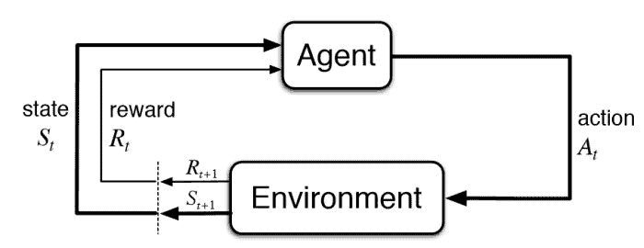
Methodology
Integration of RL model (Q-Learning) for path optimization
Adaptability: Ability to learn effectively from real-time thermal feedback
Real-time applicability: Decisions made instantly based on changing states
Computational Simplicity: Quick iterations with minimal computation.
Notes:
The methods that you have chose and why
How was the problem understood, characterized, analyzed or solved?

Slide 13
Approach
1. Problem Definition and Planning
Clearly defined goals:
Develop accurate simulations for thermal dynamics.
Optimize printing sequences using AI (Reinforcement Learning).
Planning the workflow:
Identified the software and resources needed (ABB RobotStudio, Python).
Notes:
Describe how you tackled the problem and worked on it
Details of models, formulations and techniques applied into your work (if applicable)
Provide a description of the experimental setting or set of data used to test (if applicable)

Slide 14
Approach
2. Data Acquisition and Virtual Simulation
Simulated the WAAM process virtually:
Created a virtual environment in ABB RobotStudio to mimic real machine parameters (speed, paths, printing layers).
Collected TCP (Tool Center Point) coordinates:
Gathered high-frequency data during simulated prints. (20 pts/sec)
Ensured accuracy by filtering and removing outliers.
Notes:
Describe how you tackled the problem and worked on it
Details of models, formulations and techniques applied into your work (if applicable)
Provide a description of the experimental setting or set of data used to test (if applicable)

Slide 15
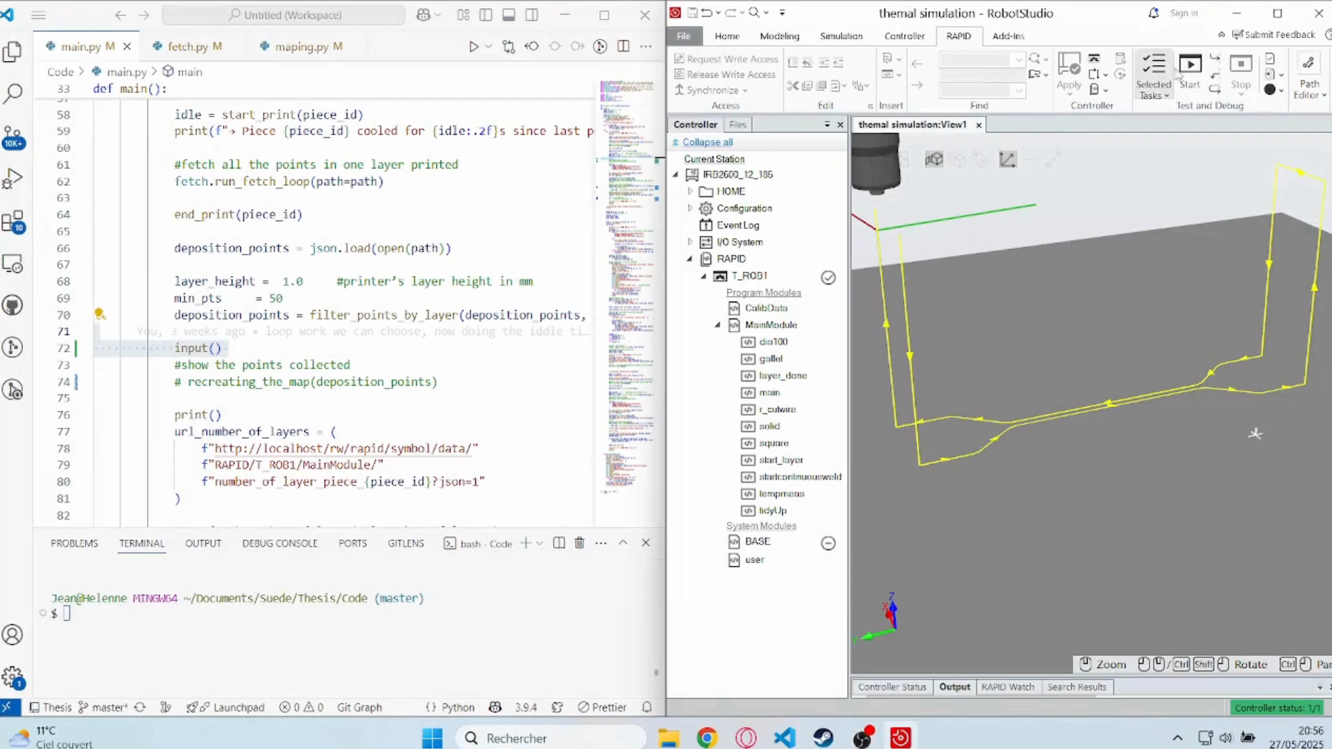
Approach
Notes:
Describe how you tackled the problem and worked on it
Details of models, formulations and techniques applied into your work (if applicable)
Provide a description of the experimental setting or set of data used to test (if applicable)

Slide 16
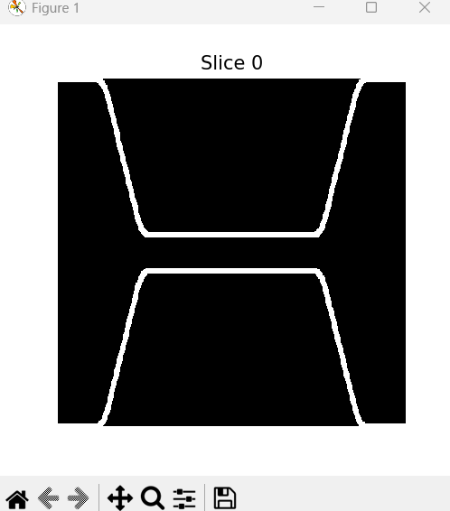
Approach
3. Geometric Representation (Voxel Method)
Converted raw data into voxel models:
400*400 resolution
Mapped raw TCP coordinates into voxel indices.
Filled gaps between voxels to ensure accurate geometry representation (by doing a dilation).
Implemented voxel methods:
Chosen due to computational efficiency and easy integration with thermal modeling.
Notes:
Describe how you tackled the problem and worked on it
Details of models, formulations and techniques applied into your work (if applicable)
Provide a description of the experimental setting or set of data used to test (if applicable)

Slide 17
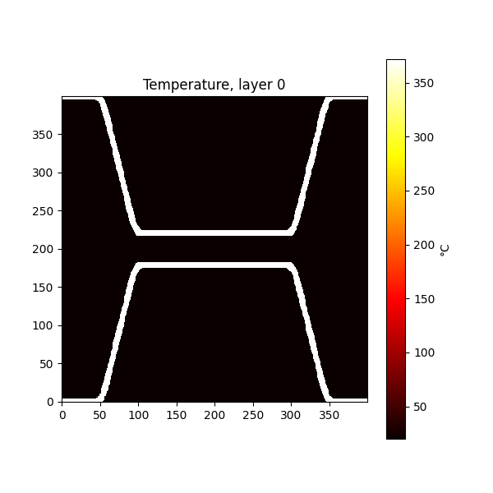
Approach
4. Thermal Simulation
Created a custom thermal model:
Developed a simplified lumped-parameter thermal equation for each piece, by taking into parameters the pieces geometry and there cooling times.
Calibrated empirical parameters (α, β, γ) through multiple iterations to reflect realistic thermal dynamics.
Validated thermal models:
Ensured accuracy by comparing results from different scenarios and real data.
Notes:
Describe how you tackled the problem and worked on it
Details of models, formulations and techniques applied into your work (if applicable)
Provide a description of the experimental setting or set of data used to test (if applicable)

Slide 18
Approach
dT/dt​=αQ−β(T−Tamb​)−γ(T^4−Tamb^4​)
Where:
T: Temperature of voxel
Q: Heat input (from welding arc)
α,β,γ: Empirically determined parameters, and changes to the piece’s geometry as well as their cooling times
Tamb: Ambient temperature
Notes:
Describe how you tackled the problem and worked on it
Details of models, formulations and techniques applied into your work (if applicable)
Provide a description of the experimental setting or set of data used to test (if applicable)

Slide 19
Approach
alpha = (0.8 x compactness + 0.9 x (1 / (1 + thickness)) + 0.8 x density)x((number_layer+23)/25)
beta = (0.03 + 0.01 x (1 - compactness) + 0.05 x (gap / 50.0))x((time_cooling)^2) #for more realism divide cooling time by 10
gamma = (1e-6 + 5e-6 x compactness + 1e-6 x (distance /50.0))x((time_cooling)^1.05) #for more realism divide cooling time by 12
Notes:
Describe how you tackled the problem and worked on it
Details of models, formulations and techniques applied into your work (if applicable)
Provide a description of the experimental setting or set of data used to test (if applicable)

Slide 20
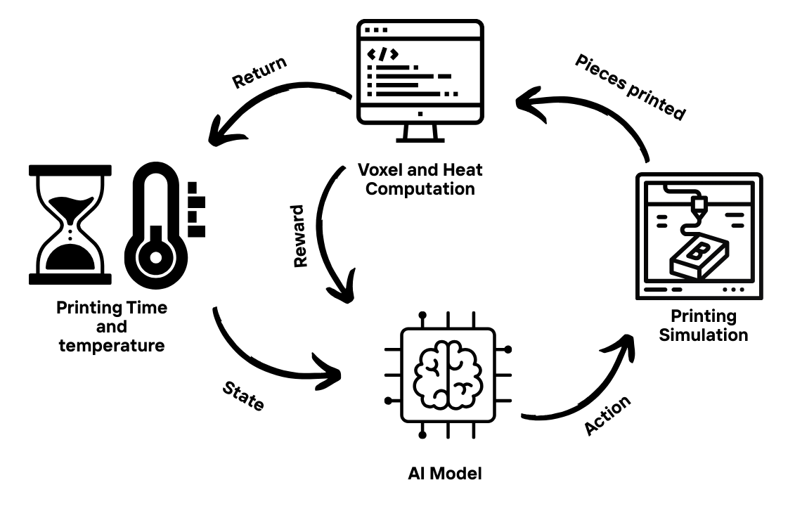
Approach
5. Integration of AI for Path Optimization
Implemented Reinforcement Learning (Q-learning):
Defined clear states (temperature, cooling time, layers), actions (choosing next piece), and rewards (minimizing wait times).
Integrated RL directly into the thermal simulation pipeline for real-time decision-making.
Iterative refinement:
Continuously refined the RL model through numerous training episodes and trials to optimize performance.
Notes:
Describe how you tackled the problem and worked on it
Details of models, formulations and techniques applied into your work (if applicable)
Provide a description of the experimental setting or set of data used to test (if applicable)

Slide 21
Approach
5. Integration of AI for Path Optimization
If piece below the threshold:
AI can choose it
then piece is being printed, the heat is re calculated for every pieces and AI take the decision again
If no piece is ready:
it waits 10 seconds for more cooling and recalculate the heat
The AI’s reward system minimize the waiting time
Notes:
Describe how you tackled the problem and worked on it
Details of models, formulations and techniques applied into your work (if applicable)
Provide a description of the experimental setting or set of data used to test (if applicable)

Slide 22
Approach
5. Integration of AI for Path Optimization
The Q-value for the (state, action) pair is updated using the Q-learning formula :
Q(s,a)←Q(s,a)+α[reward+γ⋅max(Q(s′,a′))−Q(s,a)] Where:
α:Learning rate (how much new information overrides old information)
γ : Discount factor (importance of future rewards)
Notes:
Describe how you tackled the problem and worked on it
Details of models, formulations and techniques applied into your work (if applicable)
Provide a description of the experimental setting or set of data used to test (if applicable)

Slide 23
Approach
6. Testing and Validation
Performed extensive experimentation:
Conducted over 200 iterative trials to refine voxel representations.
Conducted over 300 iterative trials to refine thermal and RL parameters.
Analyzed results systematically to confirm improvements in efficiency and accuracy.
Printing 4 pieces each time with diverse geometry complexity.
Compare results of the RL model with a deterministic algorithm to see if an improvement is present.
Notes:
Describe how you tackled the problem and worked on it
Details of models, formulations and techniques applied into your work (if applicable)
Provide a description of the experimental setting or set of data used to test (if applicable)

Slide 24
Results
Thermal Simulation Effectiveness
Mandatory to improve the printing schedule, core part of the thesis
Developed a robust, simplified heat simulation model.
Achieved realistic temperature profiles across different layers and piece geometries through calibrated empirical parameters (α, β, γ).
Voxel Representation Accuracy
Achieved precise voxel-based representation of the printed pieces.
Crucial for effective thermal analysis through accurate and efficient geometric modeling.
Notes:
This should give the audience a good understanding of what you have discovered during your work
The results should answer the question: What are the main findings acquired from the work?

Slide 25
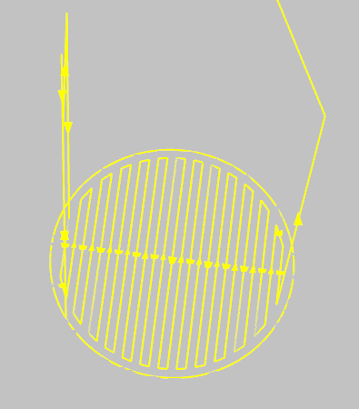

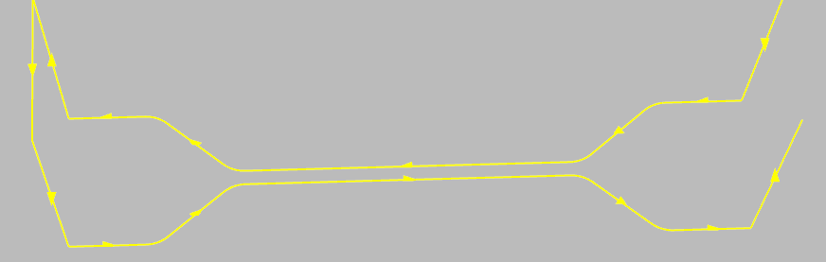
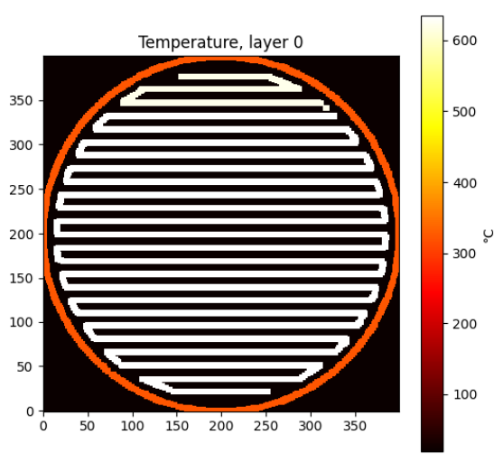
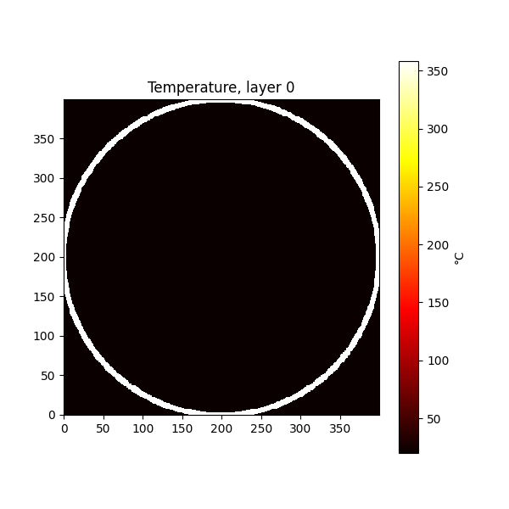
Results
Notes:
This should give the audience a good understanding of what you have discovered during your work
The results should answer the question: What are the main findings acquired from the work?

Slide 26
Results
Efficiency Gains through Reinforcement Learning
Reinforcement Learning (Q-learning) significantly optimized printing sequences.
Achieved notable efficiency improvements:
Up to 13.16% reduction in total build time compared to deterministic path selection algorithms.
Consistently better performance with realistic thermal parameter tuning.
Notes:
This should give the audience a good understanding of what you have discovered during your work
The results should answer the question: What are the main findings acquired from the work?

Slide 27
Results
Test Scenario | RL Model Time (s) | Algorithm Time (s) | Improvement (%)
5-layer test scenario | 1548.43 s | 1604.12 s | +3.47% (RL faster)
10-layer realistic scenario | 6314.76 s | 7271.21 s | +13.16% (RL faster)
5-layer refined scenario | 2575.98 s | 2629.95 s | +2.05% (RL faster)
Notes:
This should give the audience a good understanding of what you have discovered during your work
The results should answer the question: What are the main findings acquired from the work?

Slide 28
Discussion
Results:
The results were up to the expectations with a faster printing methods using RL than deterministic or just no algorithm at all.
The literature study results were also showing a better performance with RL methods.
Recommendations:
Digging more into RL driven path selection for metal 3d printing in WAAM.
Notes:
Discuss how the results relate to your expected results and the results from the literature study
What are the recommendations based on your results in the work? For practitioners and scientific?

Slide 29
Conclusion
Aims and how the results fulfilled them:
Develop a realistic, physics-based simulation model for WAAM
Implement an accurate voxel-based representation of printed pieces
Perform thermal simulations to optimize printing sequences
Use Reinforcement Learning (RL) to autonomously improve build sequences
Notes:
Restate your works aim
Show how your results fulfil this
Show the contribution you have made
State the limitations to the work you have made

Slide 30
Conclusion
Contributions:
Voxel Representation
Heat simulation
First RL trials
Notes:
Restate your works aim
Show how your results fulfil this
Show the contribution you have made
State the limitations to the work you have made

Slide 31
Conclusion
Limitations:
General heat simulation for the whole piece
No deep Reinforcement Learning
No real trial on the real machine
Notes:
Restate your works aim
Show how your results fulfil this
Show the contribution you have made
State the limitations to the work you have made

Slide 32
Future work
Deep Q-learning RL (take heat map into parameter)
Simulate heat on each voxel according to the voxel’s cooling time instead of the piece
Better heat simulation that simulate on every layer of the piece at once, and better propagation through the piece
Notes:
Suggest future work, research and/or industrial

Slide 33
Thanks for your interest! JUSTINE Jean
Notes:
All red text shall be replaced AND changed to BLACK colour

